Slide 1
Lecture 7: Vector (cont.)
Principles of Information Retrieval
Prof. Ray Larson
University of California, Berkeley
School of Information

Slide 2
Review
IR Models
Vector Space Introduction

Slide 3
IR Models
Set Theoretic Models
  Boolean
  Fuzzy
  Extended Boolean
Vector Models (Algebraic)
Probabilistic Models (probabilistic)

Slide 4
Vector Space Model
Documents are represented as vectors in term space
  Terms are usually stems
  Documents represented by binary or weighted vectors of terms
Queries represented the same as documents
Query and Document weights are based on length and direction of their vector
A vector distance measure between the query and documents is used to rank retrieved documents

Slide 5
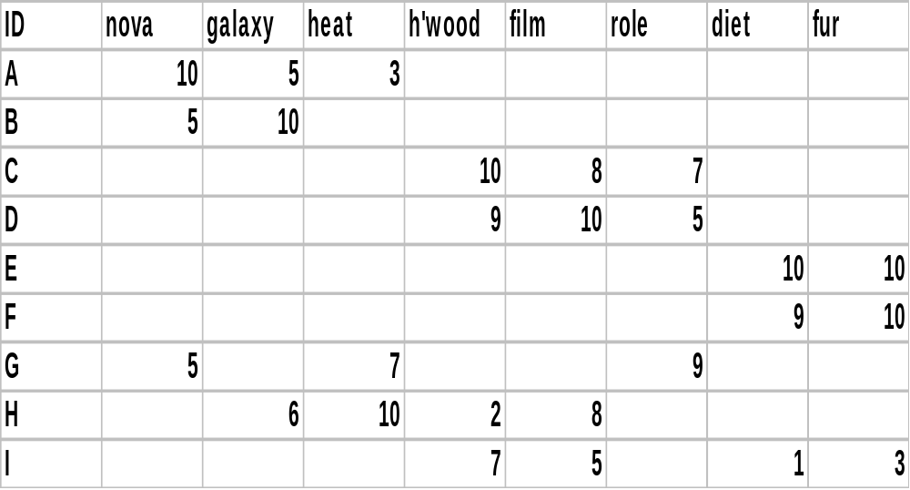
Document Vectors + Frequency
“Nova” occurs 10 times in text A
“Galaxy” occurs 5 times in text A
“Heat” occurs 3 times in text A
(Blank means 0 occurrences.)

Slide 6
We Can Plot the Vectors
Star
Doc about movie stars
Doc about astronomy
Doc about mammal behavior
Diet

Slide 7
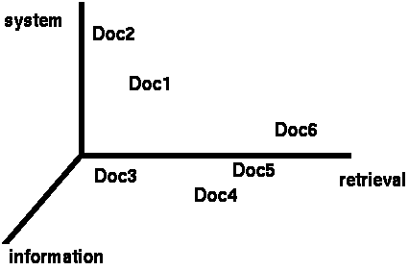
Documents in 3D Space
Primary assumption of the Vector Space Model:
Documents that are “close together” in space
are similar in meaning

Slide 8
Document Space has High Dimensionality
What happens beyond 2 or 3 dimensions?
Similarity still has to do with how many tokens are shared in common.
More terms -> harder to understand which subsets of words are shared among similar documents.
We will look in detail at ranking methods
Approaches to handling high dimensionality: Clustering and LSI (later)

Slide 9
Assigning Weights to Terms
Binary Weights
Raw term frequency
tf*idf
  Recall the Zipf distribution
  Want to weight terms highly if they are
    Frequent in relevant documents … BUT
    Infrequent in the collection as a whole
Automatically derived thesaurus terms

Slide 10
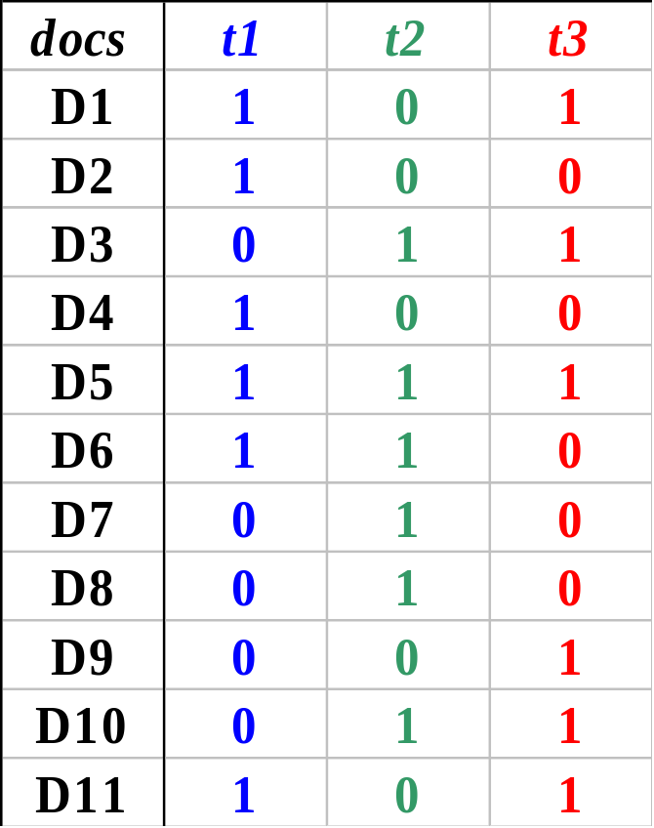
Binary Weights
Only the presence (1) or absence (0) of a term is included in the vector

Slide 11
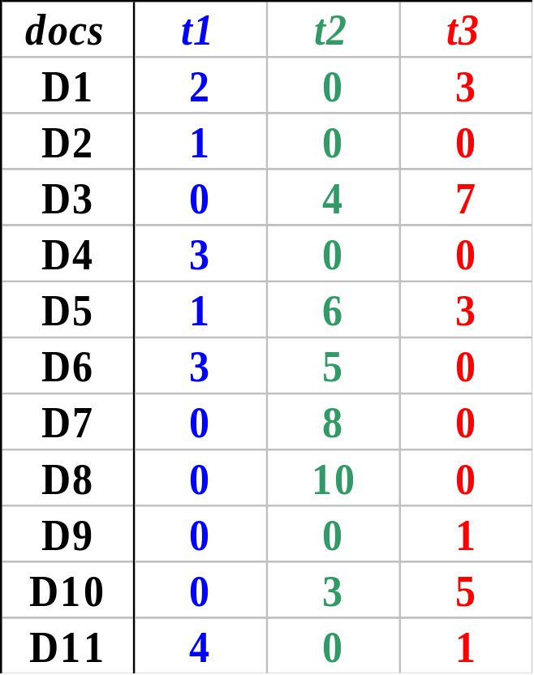
Raw Term Weights
The frequency of occurrence for the term in each document is included in the vector

Slide 12
Assigning Weights
tf*idf measure:
  Term frequency (tf)
  Inverse document frequency (idf)
    A way to deal with some of the problems of the Zipf distribution
Goal: Assign a tf*idf weight to each term in each document

Slide 13
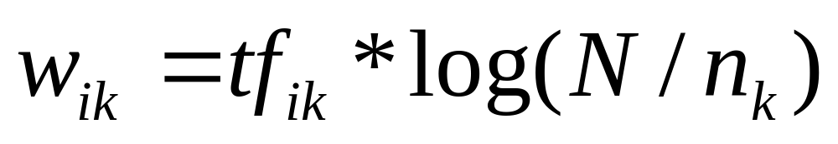
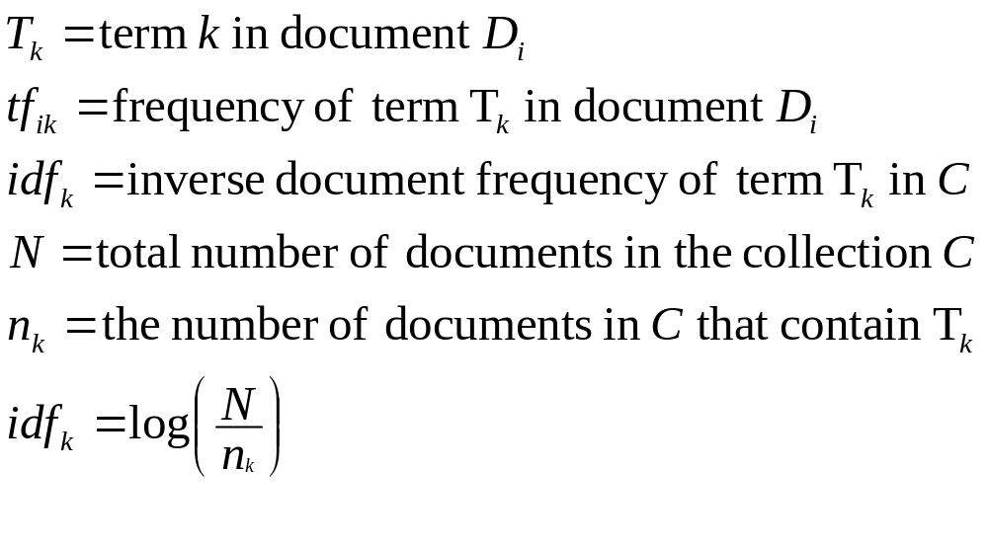
Simple tf*idf

Slide 14
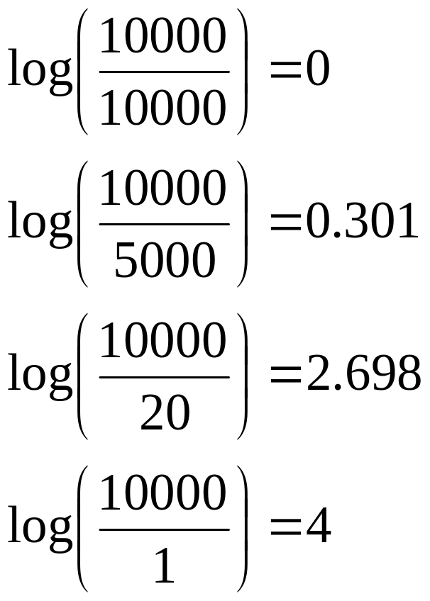
Inverse Document Frequency
IDF provides high values for rare words and low values for common words
For a collection
of 10000 documents
(N = 10000)

Slide 15
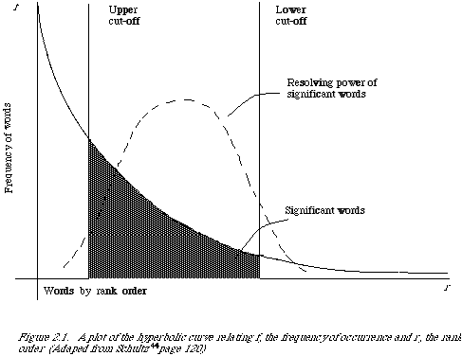
Word Frequency vs. Resolving Power
The most frequent words are not the most descriptive.
(from van Rijsbergen 79)

Slide 16
Non-Boolean IR
Need to measure some similarity between the query and the document
The basic notion is that documents that are somehow similar to a query, are likely to be relevant responses for that query
We will revisit this notion again and see how the Language Modelling approach to IR has taken it to a new level

Slide 17
Non-Boolean?
To measure similarity we…
  Need to consider the characteristics of the document and the query
  Make the assumption that similarity of language use between the query and the document implies similarity of topic and hence, potential relevance.

Slide 18
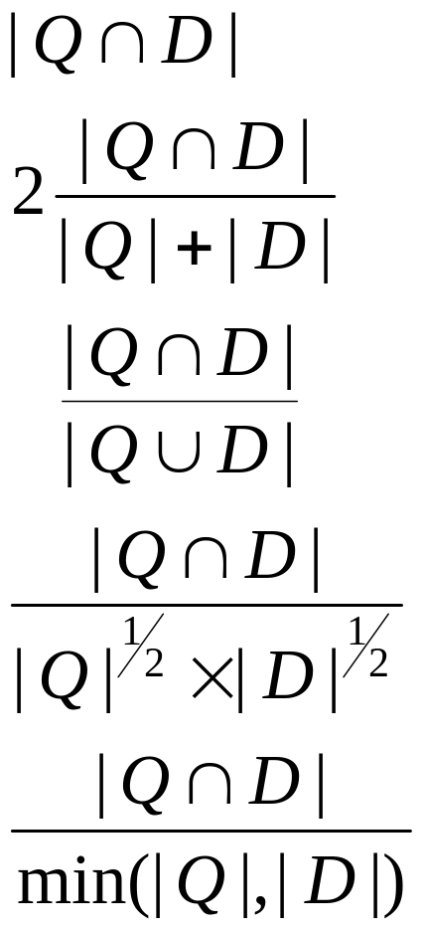
Similarity Measures (Set-based)
Assuming that Q and D are the sets of terms associated with a
Query and Document:
Simple matching (coordination level match)
Dice’s Coefficient
Jaccard’s Coefficient
Cosine Coefficient
Overlap Coefficient

Slide 19
Today
Vector Matching
SMART Matching options
Calculating cosine similarity ranks
Calculating TF-IDF weights
How to Process a query in a vector system?
Extensions to basic vector space and pivoted vector space

Slide 20
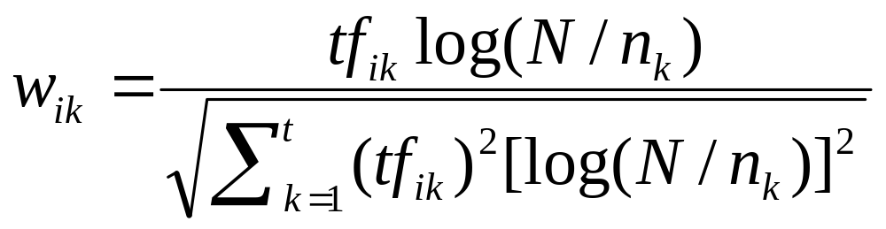
tf x idf normalization
Normalize the term weights (so longer documents are not unfairly given more weight)
  normalize usually means force all values to fall within a certain range, usually between 0 and 1, inclusive.

Slide 21
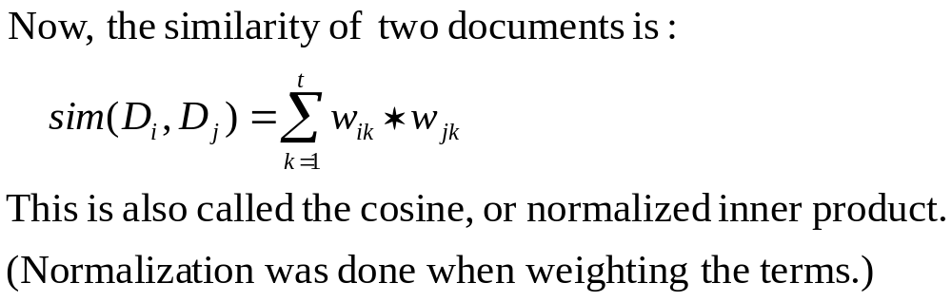
Vector space similarity
Use the weights to compare the documents

Slide 22
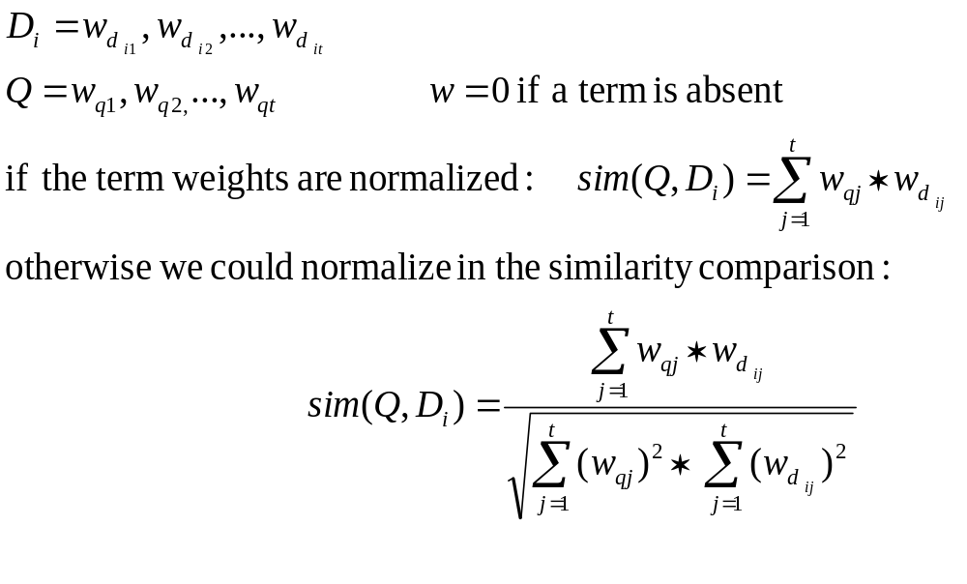
Vector Space Similarity Measure
combine tf x idf into a measure

Slide 23
Weighting schemes
We have seen something of
  Binary
  Raw term weights
  TF*IDF
There are many other possibilities
  IDF alone
  Normalized term frequency

Slide 24
Term Weights in SMART
SMART is an experimental IR system developed by Gerard Salton (and continued by Chris Buckley) at Cornell.
Designed for laboratory experiments in IR
  Easy to mix and match different weighting methods
  Really terrible user interface
  Intended for use by code hackers

Slide 25
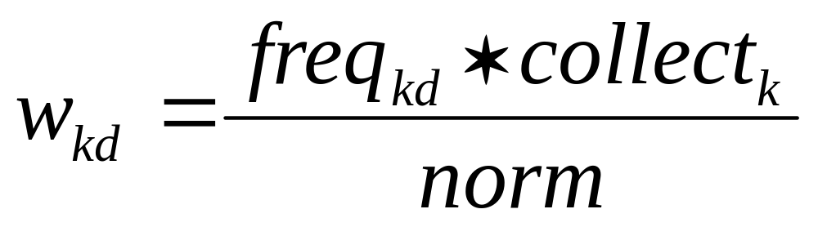
Term Weights in SMART
In SMART weights are decomposed into three factors:

Slide 26
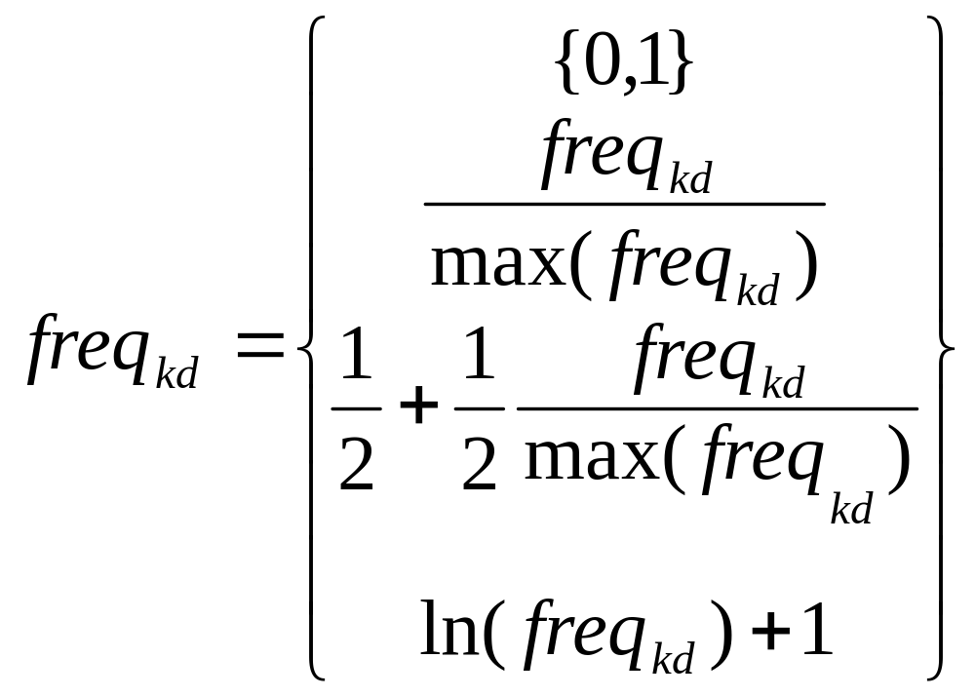
SMART Freq Components
Binary
maxnorm
augmented
log

Slide 27
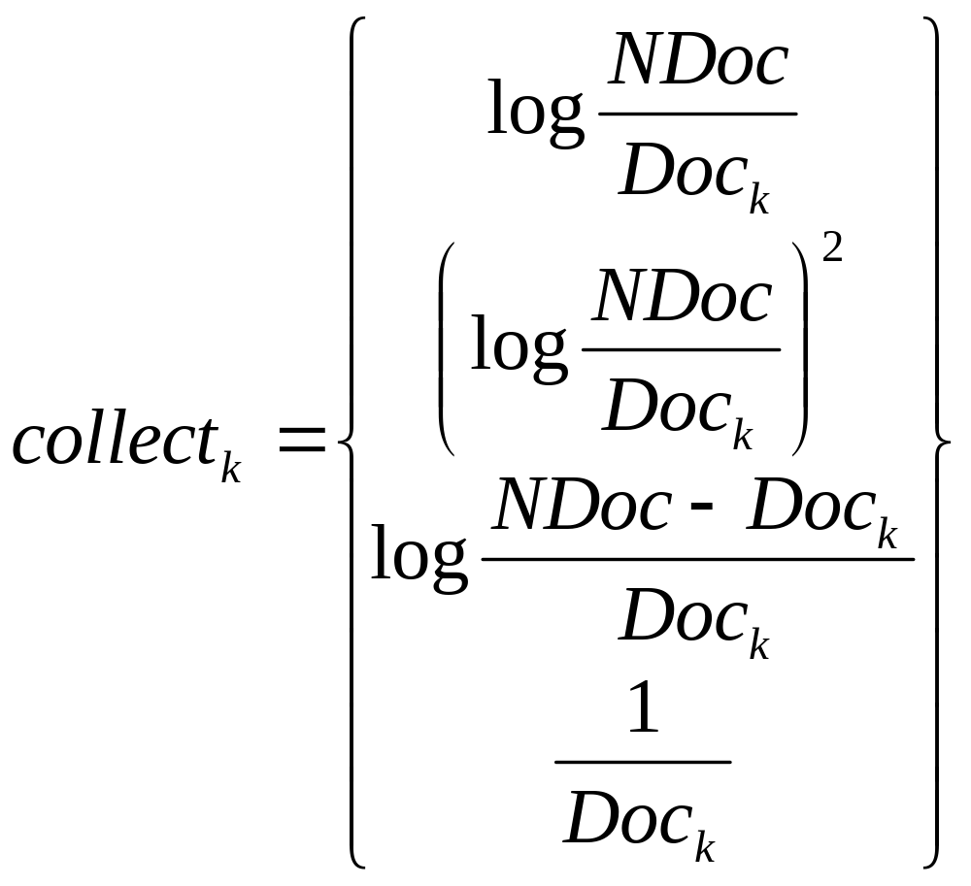
Collection Weighting in SMART
Inverse
squared
probabilistic
frequency

Slide 28
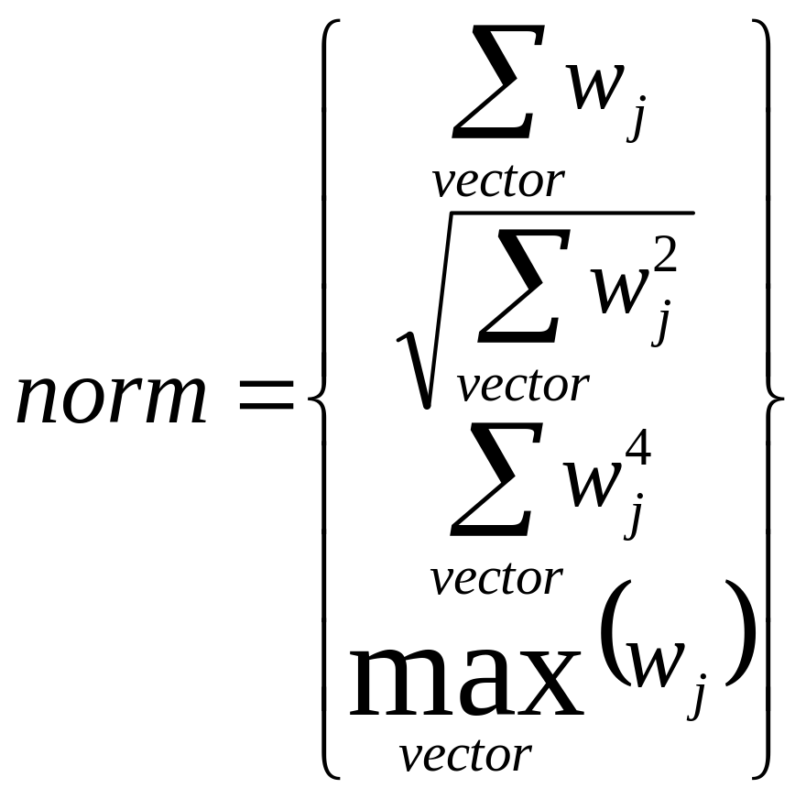
Term Normalization in SMART
sum
cosine
fourth
max

Slide 29
How To Process a Vector Query
Assume that the database contains an inverted file like the one we discussed earlier…
  Why an inverted file?
  Why not a REAL vector file?
What information should be stored about each document/term pair?
  As we have seen SMART gives you choices about this…

Slide 30
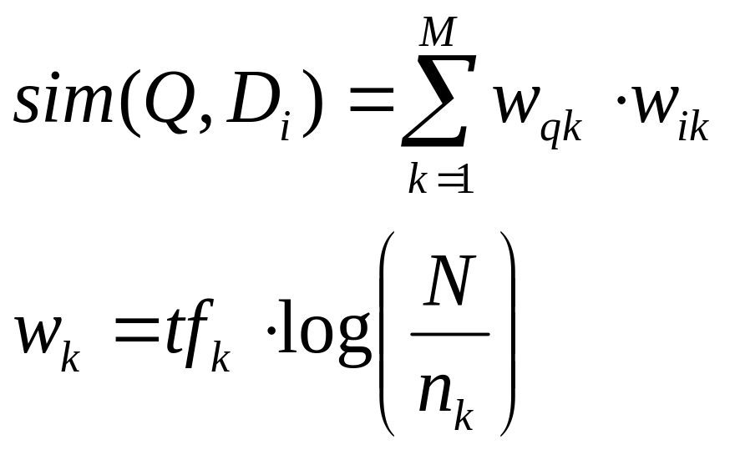
Simple Example System
Collection frequency is stored in the dictionary
Raw term frequency is stored in the inverted file postings list
Formula for term ranking

Slide 31
Processing a Query
For each term in the query
  Count number of times the term occurs – this is the tf for the query term
  Find the term in the inverted dictionary file and get:
    n_{k} : the number of documents in the collection with this term
    Loc : the location of the postings list in the inverted file
    Calculate Query Weight: w_{qk}
    Retrieve n_{k} entries starting at Loc in the postings file

Slide 32
Processing a Query
Alternative strategies…
  First retrieve all of the dictionary entries before getting any postings information
    Why?
  Just process each term in sequence
How can we tell how many results there will be?
  It is possible to put a limitation on the number of items returned
    How might this be done?

Slide 33
Processing a Query
Like Hashed Boolean OR:
  Put each document ID from each postings list into hash table
    If match increment counter (optional)
      If first doc, set a WeightSUM variable to 0
    Calculate Document weight w_{ik} for the current term
    Multiply Query weight and Document weight and add it to WeightSUM
Scan hash table contents and add to new list – including document ID and WeightSUM
Sort by WeightSUM and present in sorted order

Slide 34
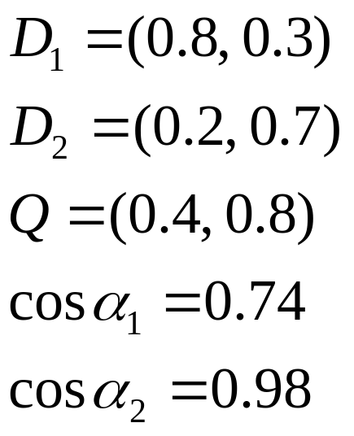





Computing Cosine Similarity Scores
1.0
0.8
0.6
0.4
0.2
0.2
0.4
0.6
0.8
1.0

Slide 35
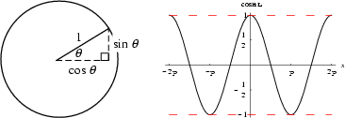
What’s Cosine anyway?
One of the basic trigonometric functions encountered in trigonometry.
Let theta be an angle measured counterclockwise from the x-axis along the
arc of the unit circle. Then cos(theta) is the horizontal coordinate of the arc
endpoint. As a result of this definition, the cosine function is periodic
with period 2pi.
From http://mathworld.wolfram.com/Cosine.html

Slide 36
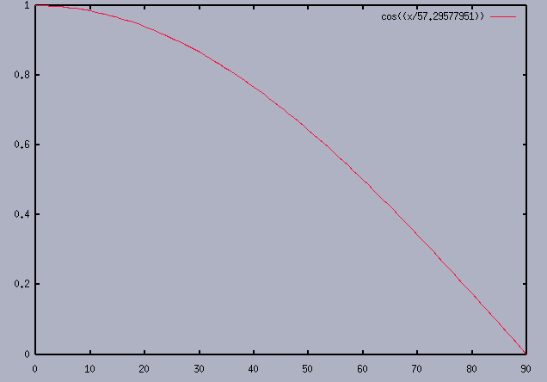
Cosine Detail (degrees)

Slide 37
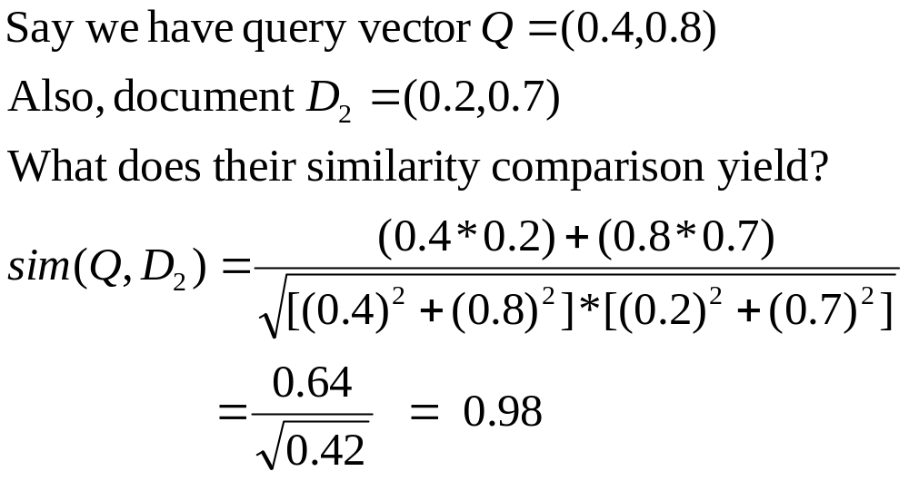
Computing a similarity score

Slide 38
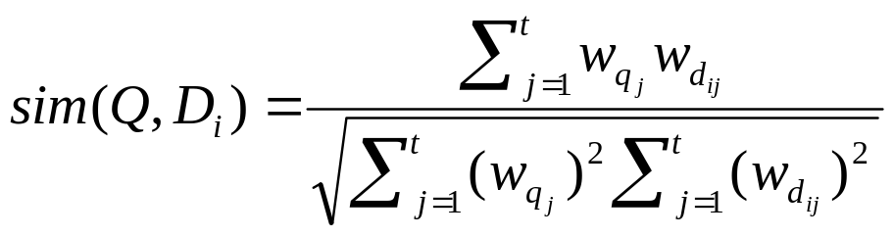

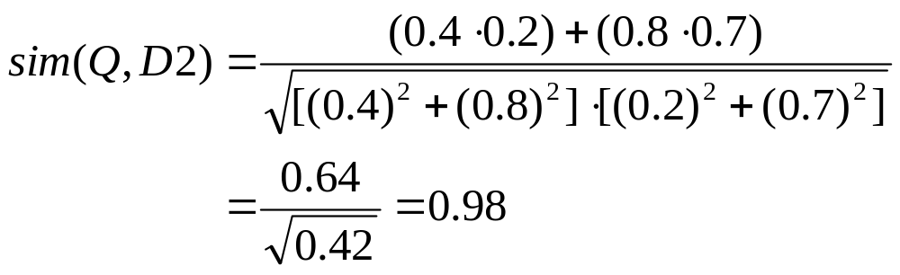

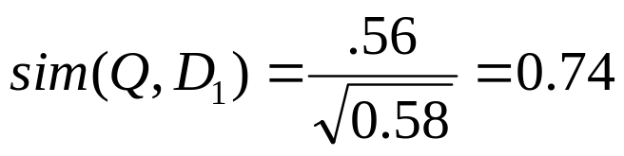
Vector Space with Term Weights and Cosine Matching
D_{i}=(d_{i1},w_{di1};d_{i2}, w_{di2};…;d_{it}, w_{dit})
Q =(q_{i1},w_{qi1};q_{i2}, w_{qi2};…;q_{it}, w_{qit})
Term B
1.0
Q = (0.4,0.8)
D1=(0.8,0.3)
D2=(0.2,0.7)
D₂
Q
0.8
0.6
0.4
D₁
0.2
0
0.2
0.4
0.6
0.8
1.0
Term A

Slide 39
Problems with Vector Space
There is no real theoretical basis for the assumption of a term space
  it is more for visualization that having any real basis
  most similarity measures work about the same regardless of model
Terms are not really orthogonal dimensions
  Terms are not independent of all other terms

Slide 40
Vector Space Refinements
As we saw earlier, the SMART system included a variety of weighting methods that could be combined into a single vector model algorithm
Vector space has proven very effective in most IR evaluations
Salton in a short article in SIGIR Forum (Fall 1981) outlined a “Blueprint” for automatic indexing and retrieval using vector space that has been, to a large extent, followed by everyone doing vector IR

Slide 41
Vector Space Refinements
Singhal (one of Salton’s students) found that the normalization of document length usually performed in the “standard tfidf” tended to overemphasize short documents
He and Chris Buckley came up with the idea of adjusting the normalization document length to better correspond to observed relevance patterns
The “Pivoted Document Length Normalization” provided a valuable enhancement to the performance of vector space systems

Slide 42
Pivoted Normalization
Probability of
Retrieval
Probability
Probability of
Relevance
Pivot
Document Length

Slide 43
Pivoted Normalization
New
Normalization
Final Normalization Factor
Old
Normalization
Pivot
Old Normalization Factor

Slide 44
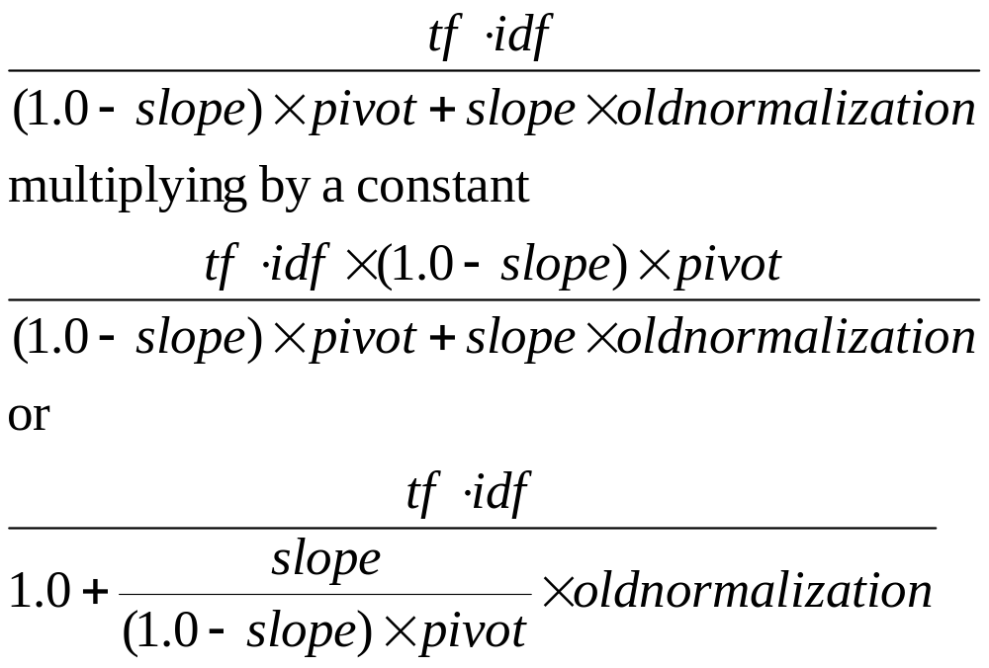
Pivoted Normalization
Using pivoted normalization the new tfidf weight for a document can be written as:

Slide 45
Pivoted Normalization
Training from past relevance data, and assuming that the slope is going to be consistent with new results, we can adjust to better fit the relevance curve for document size normalization

